Slide 1
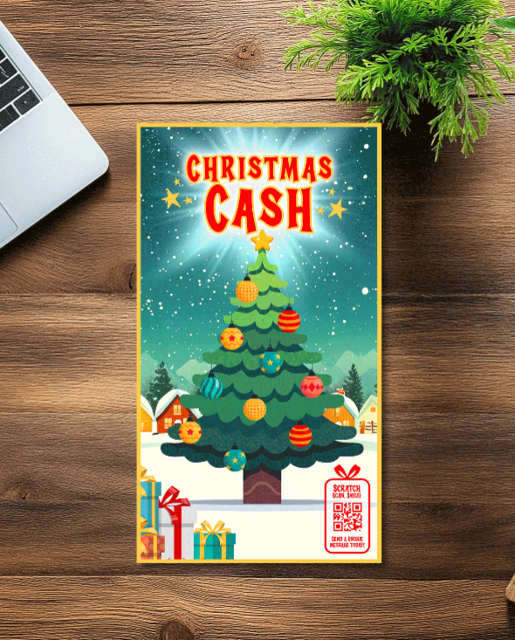
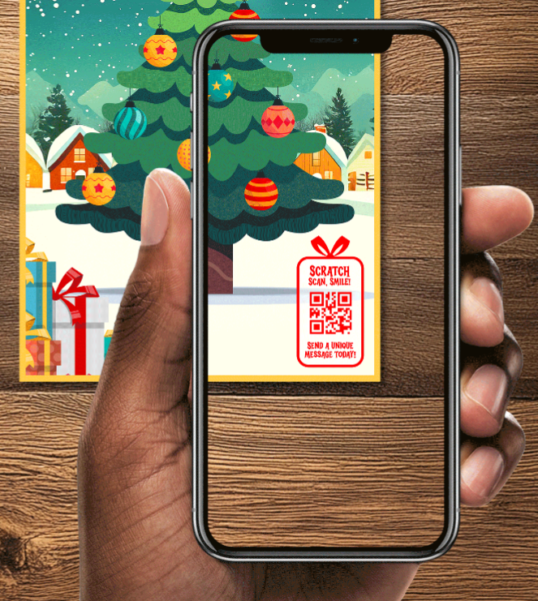
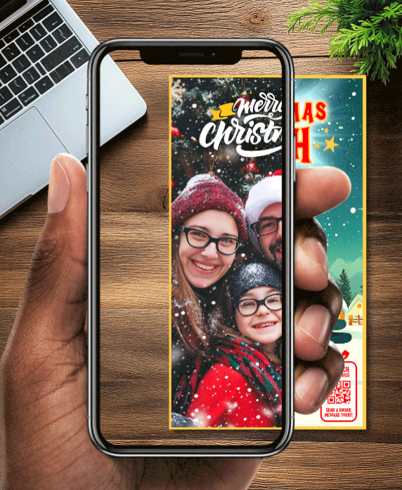
Imagine that a new personalised video scratchcard has been launched:
Christmas AR Message
🎁 This Christmas-themed scratchcard was designed with a unique feature for gifting during the holidays. It retails for $10 and comes with a guaranteed win for the recipient.
On the front of the main scratchcard, there is a QR code, which you can scan with your phone. When you scan the code, you can then record a short video of yourself wishing the person you are gifting it to a Merry Christmas. After recording the message, a Christmas filter is added over the top, with a festive design.
🎄 Once the scratchcard has been gifted, the receiver can play the scratchcard, uncover their win, and then scan the QR code. The personal festive message you recorded for them will then appear over the scratchcard, brought to life using augmented reality and fun digital animations.
Notes:
Christmas AR Message

Slide 2
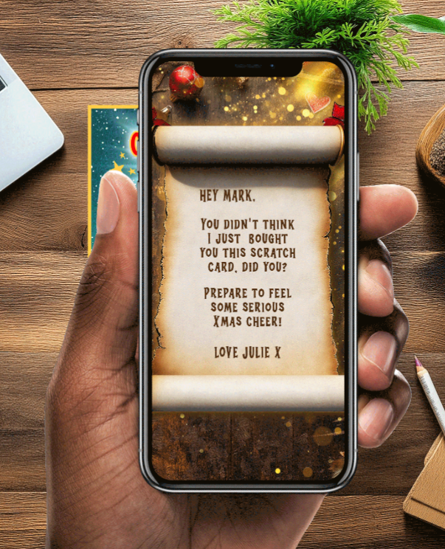
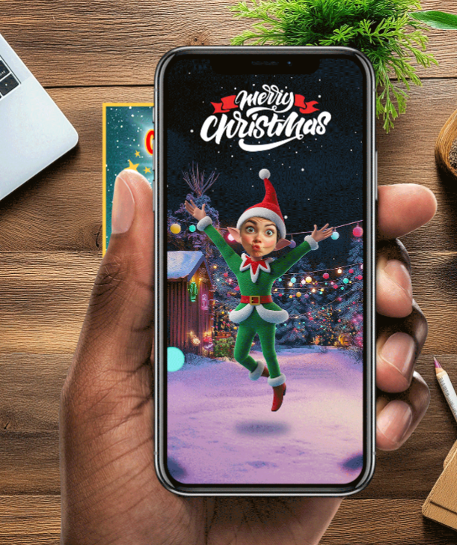
Imagine that a fun new themed augmented reality scratchcard has been launched:
Elf Yourself
🎁 This Christmas-themed scratchcard was designed with a unique feature for gifting during the holidays. It retails for $10 and comes with a guaranteed win for the recipient.
On the front of the scratchcard, there is a QR code. When scanned you can write a short Merry Christmas message to the person you are gifting the scratchcard to. You can then upload a picture or take a selfie which is projected onto dancing elf bodies, creating a fun personalised festive video with festive music, similar to the hit social media trend “Elf Yourself”.
🎄Once the scratchcard has been gifted, the receiver can play the scratchcard, uncover their win, and then scan the QR code.
The personal festive message you recorded for them will then appear over the scratchcard showing your Christmas message in a decorative design followed by the fun personalised elf video.
Notes:
Elf Yourself

Slide 3
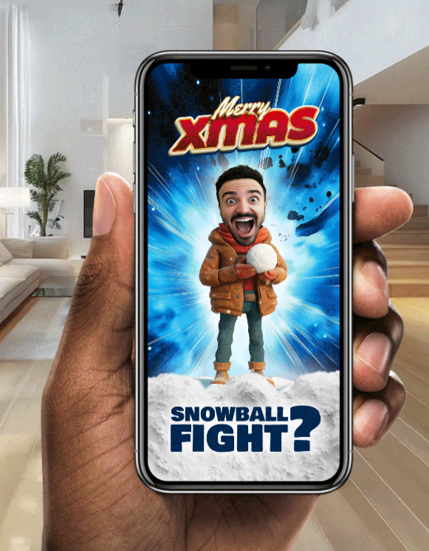
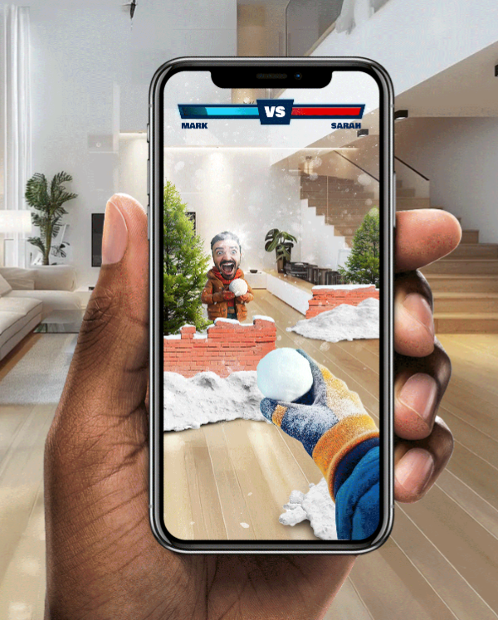
Imagine that a new Augmented Reality minigame can be played on your scratchcard
AR Christmas Mini Game
🎁 This Christmas-themed scratchcard was designed with a unique feature for gifting during the holidays. It retails for $10 and comes with a guaranteed win for the recipient.
On the front of the scratchcard, there is a QR code, which you can scan with your phone. When you scan the code, you can write a short Christmas message to the person you are gifting the scratchcard to and upload a photo or a selfie.
🎄 Once the scratchcard has been gifted, the receiver can play the scratchcard, uncover their win, and then scan the same QR code to play an additional digital mini-game.
The recipient holds up their phone and takes a photo of their environment. Augmented reality overlays an animation of a holiday-themed snowball fight, complete with snowbanks, walls, and a playful animated character opponent that pops up to throw snowballs at you. You win by flicking snowballs back and hitting your opponent.
Notes:
AR Christmas Mini Game

Slide 4
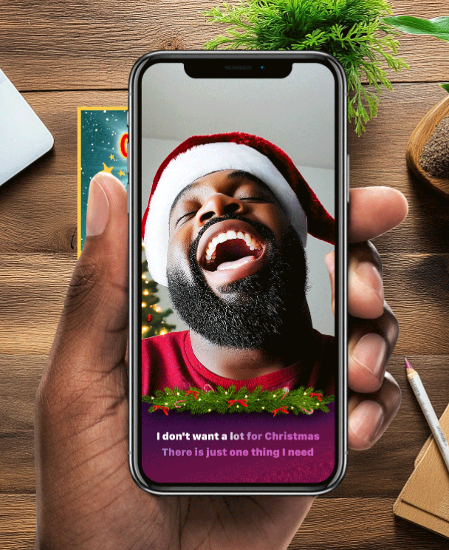
Imagine your scratchcard comes with a new lip-synching experience:
Christmas Lip Sync
🎁 This Christmas-themed scratchcard was designed with a unique feature for gifting during the holidays. It retails for $10 an comes with a guaranteed win for the recipient.
On the front of the scratchcard, there is a QR code, which you can scan with your phone, record a quick video wishing the recipient Merry Christmas, choose a festive filter and your favorite Christmas carol which you can lips-sync to.
🎄 Once the scratchcard has been gifted, the receiver can play the scratchcard, uncover their win, and then scan the QR code for a festive message. The personal Christmas video you recorded for them will then appear, with the festive overlay showing you lip-syncing your heart out with the holiday tune, and the words playing at the bottom of the screen for the receiver to join in.
Notes:
Christmas Lip Sync

Slide 5
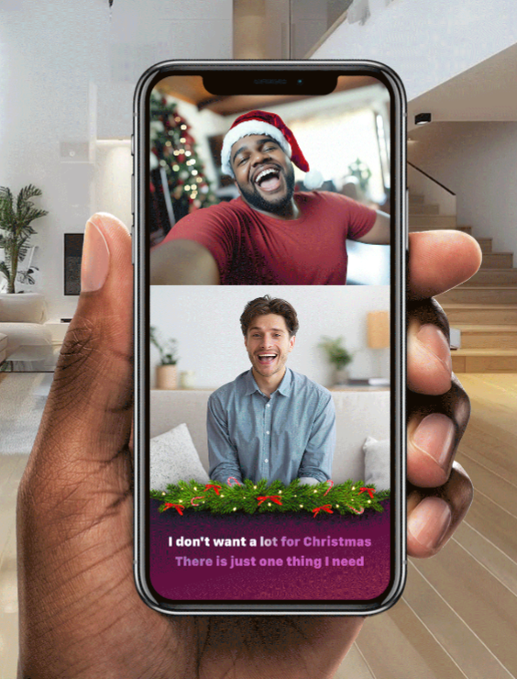
Imagine that a new scratchcard with duet lip-syncing has been launched:
Christmas Duet
🎁 This Christmas-themed scratchcard was designed with a unique feature for gifting during the holidays. It retails for $10 and comes with a guaranteed win for the recipient.
On the front of the scratchcard, there is a QR code, which you can scan with your phone, record a quick video wishing the recipient Merry Christmas, choose a festive filter and your favorite Christmas carol which you can lip-sync to.
🎄 Once the scratchcard has been gifted, the receiver can play the scratchcard, uncover their win, and then scan the QR code for a festive message. The personal Christmas video you recorded for them will then appear, and they can record themselves lip-syncing along with you. The final duet will then be available for them to share on messaging apps or social media.
Notes:
Christmas Duet

Slide 6
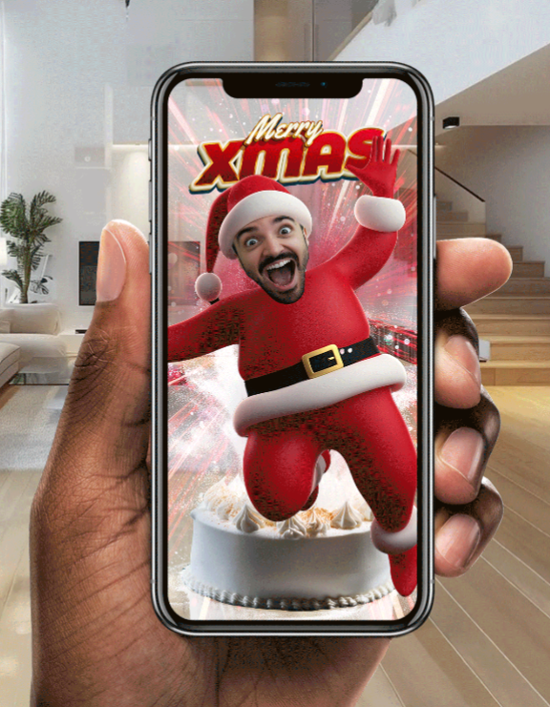
Imagine adding a personalised surprise to your Christmas scratchcard:
Christmas Cake Suprise
🎁 This Christmas-themed scratchcard was designed with a unique feature for gifting during the holidays. It retails for $10 and comes with a guaranteed win for the recipient.
On the front of the scratchcard, there is a QR code, which you can scan with your phone. As the ticket purchaser once you scan the code, you can upload a picture or take a selfie and choose a festive character (Santa, elf, reindeer).
🎄 Once the scratchcard has been gifted, the receiver can play the scratchcard, uncover their win, and then scan the same QR code which will prompt them to place a cake using space tracking and then be told to look closer…their friend will then burst out of the cake dressed as a Christmas character. The receiver's reaction will then be recorded and the whole event will then be played back as a shareable video with a Christmas message.
Notes:
Christmas Cake Suprise

Slide 7
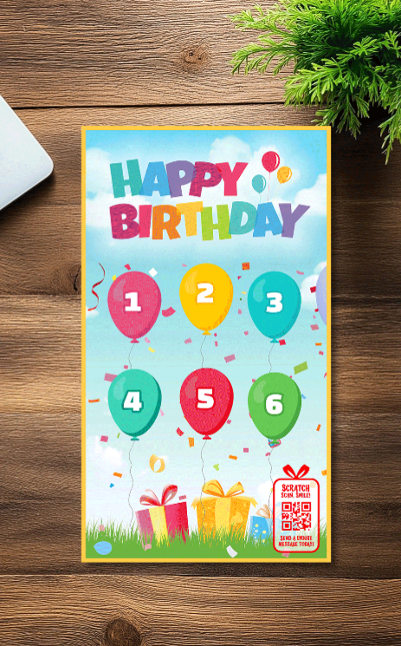
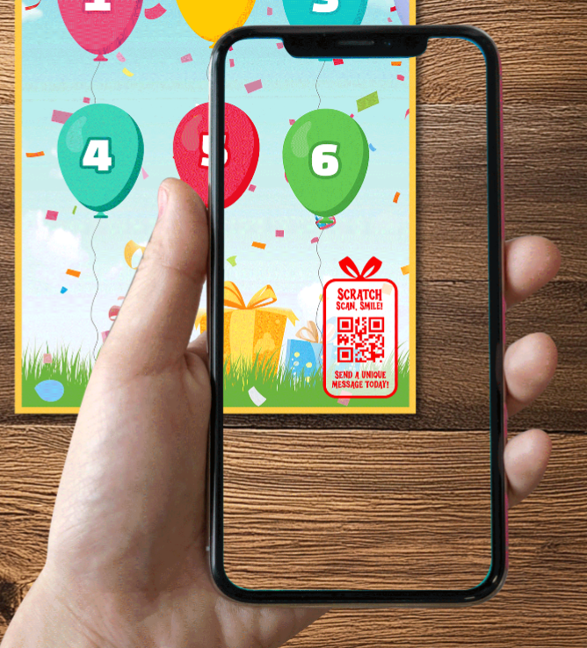
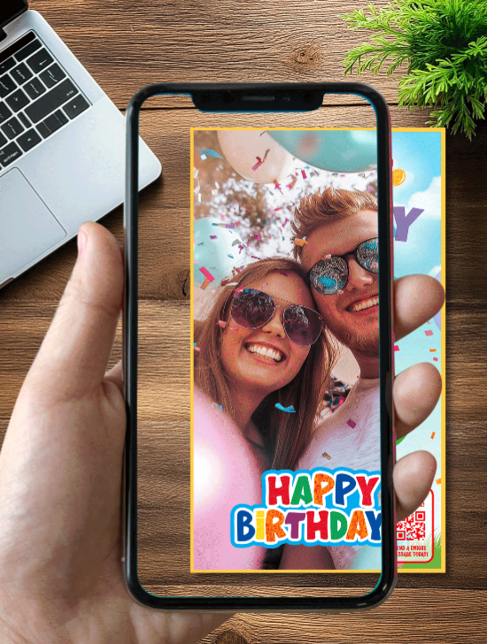
Imagine adding a personalised video message to a scratchcard for a friend's birthday:
Christmas Cake Suprise
🎁 This themed scratchcard was designed with a unique feature for gifting. It retails for $10 and comes with a guaranteed win for the recipient.
On the front of the scratchcard, there is a QR code, which you can scan with your phone. As the ticket purchaser once you scan the code, you record a happy birthday message, to a friend that you are going to give the scratchcard to.
🎉 Once the scratchcard has been gifted, the receiver can play the scratchcard, uncover their win, and then scan the QR code.
The personal message you recorded for them will then appear over the scratchcard, brought to life using augmented reality.
Notes:
Birthday Message

Slide 8
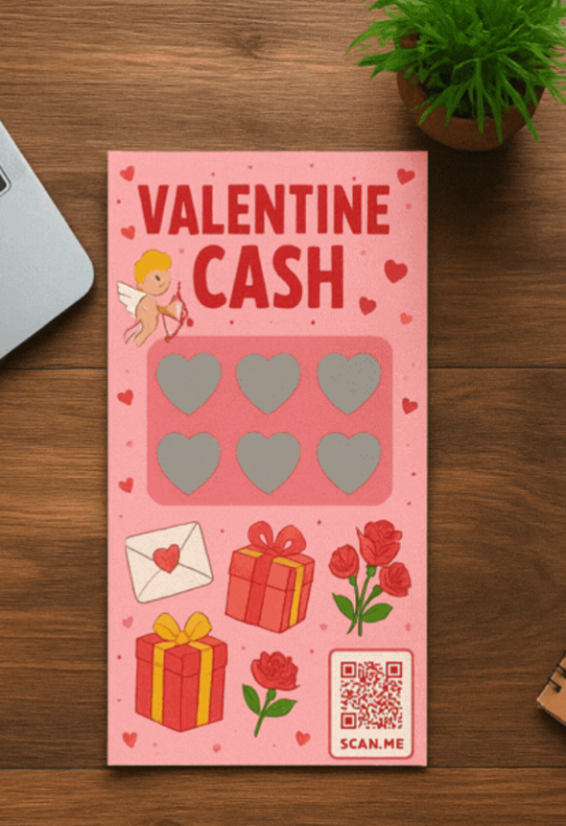
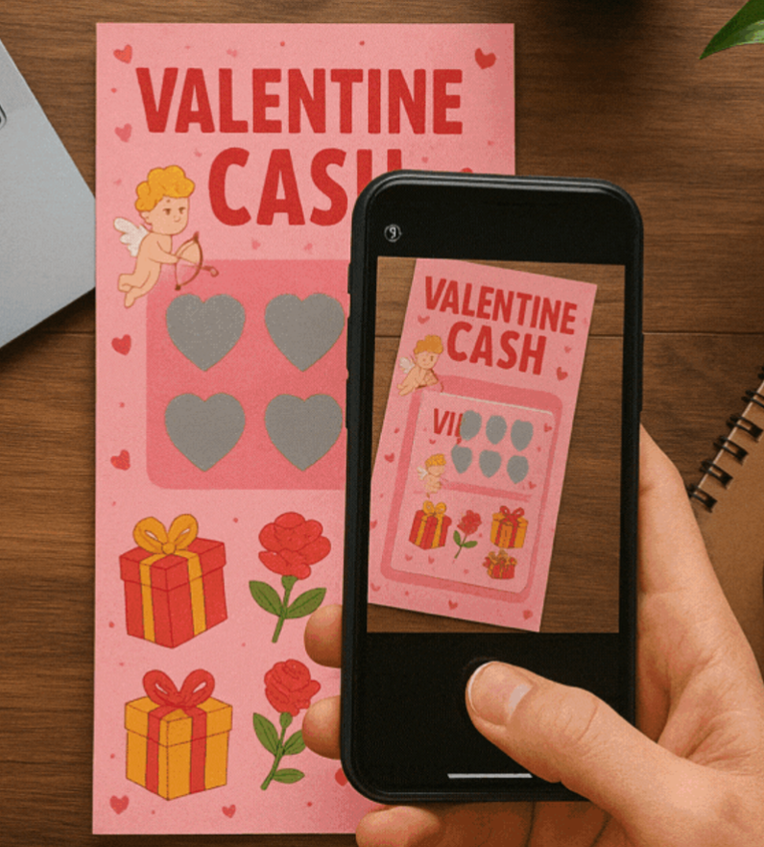
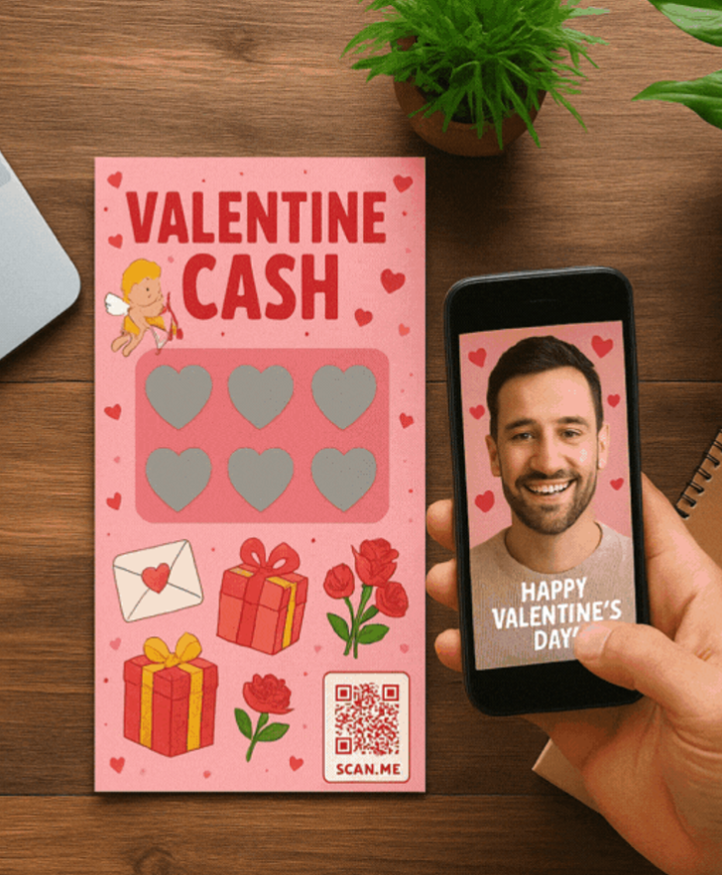
Imagine a personalised digital Valentine's Day card attached to a scratchcard.
Valentine Message
🎁 This themed scratchcard was designed with a unique feature for gifting to your loved one. It retails for $10 and comes with a guaranteed win for the recipient.
On the front of the scratchcard, there is a QR code, which you can scan with your phone. As the ticket purchaser, once you scan the code, you record a personal message for the receiver, to a friend that you are going to give the scratchcard to.
🎉Once the scratchcard has been gifted, the receiver can play the scratchcard, uncover their win, and then scan the QR code. The personal message you recorded for them will then appear over the scratchcard, brought to life using augmented reality.
Notes:
Valentine Message

